Slide 1
A History of Calculus for Instructors
Jacob Zoromski
University of Notre Dame
Graduate Student seminar 11/27/2023

Slide 2
Goal
Understand how the concepts of calculus, as taught in a standard Calculus 1 course, came to be.

Slide 3
What is Calculus?
Calculus is the study of instantaneous rates of change and areas under curves.
Concepts required:
Real number line
Function
Limit
Continuity
Derivative
Integral
And More…
Graphical representation
Algebraic notation
Intuition about infinite/infinitesimal processes
Infinite series
Order of development

Slide 4
Outline
We will follow a chronological development
Antiquity: Origins of Math (500BC-300AD)
Late Antiquity + Medieval: Changing Perspectives (300-1500)
Renaissance: Developments in Algebra and Analysis (1500-1665)
Birth of Calculus: Newton and Leibniz (1665-1687)
Foundations of Calculus: Limits and the Calculus of Today (1687-1872+)

Slide 5
Remarks
My information is from secondary sources
People cited are often exemplary, not the first to discover idea
Many important people left out

Slide 6
Antiquity: Origins of Math
500BC-300AD
Development of Geometry. Separation of number, motion, and infinite(simal) from geometry. Finding areas by “exhaustion”

Slide 7
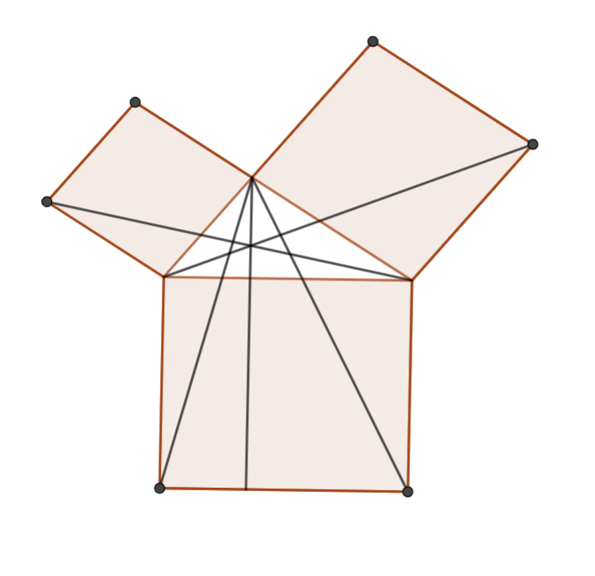
Beginnings of Geometry
First proofs and general theorems come from ancient Greece
Pythagoreans (~500BC)
Theorem (Irrationals): There are distinct line segments A and B such that there is no unit line segment small enough such that A and B are collections of units. (e.g. diagonal and side of unit square)
=> “number” and magnitude are separate
Area found by comparing shapes
The Pythagorean Theorem

Slide 8
Advanced Area Finding: Method of Exhaustion
“Method of Exhaustion” (MOE): Claim: A shape S has the same area as a shape T
Assume T is bigger than S
Inscribe a figure P (polygon) in S
Modify P by a finite process, obtaining inscribed figures P1,P2,…
Show that Pn can be as close to T as we like (Contradiction)
Repeat: Assume T is smaller than S, circumscribe, modify, contradiction
Eudoxus (423-347BC)

Slide 9
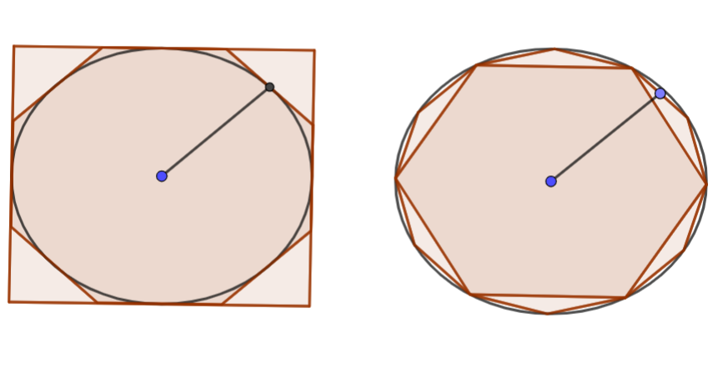
MOE Example:
=
S
r
T
C

Slide 10
Lack of Infinitude
“Atomism”, the idea that matter can be broken into tiny, indivisible parts
Democritus (460-370BC) found areas of pyramids, cones using indivisibles, but such methods fell out of favor because…
Zeno’s (495-430BC) Paradoxes: No such thing as instantaneous (or any…) motion

Slide 11
Future Influences
Euclid’s (~300BC) Elements: A text for all time
Rigorous axiomatic mathematics
Primarily geometry, number theory
Archimedes (287-212BC)
Computed Volumes, surface areas, centers of gravity of spheres, cones, parabolas, etc. using MOE
Found tangent to a spiral

Slide 12

Future Influences, Continued
Aristotle (384-322BC)
Instantaneous motion is possible, though not quantitative
No actual indivisibles, but infinite exists “potentially” and can be approached
Apollonius (15-100AD) Conics, Diophantus (214-298AD) Algebra?
A Paradox of Zeno

Slide 13
Late Antiquity and Medieval Times: Changing Perspectives
300-1500
Origins of algebra. Numerals. Graphical Representation. Comfort with the infinite

Slide 14
Numerals
Decimal system developed in India by the 6th Century, as recorded in the Aryabhatiya of Aryabhata. It combined:
Base 10
Positional notation
Symbol for each numeral 1-9 (later 0 in the 9th century)

Slide 15
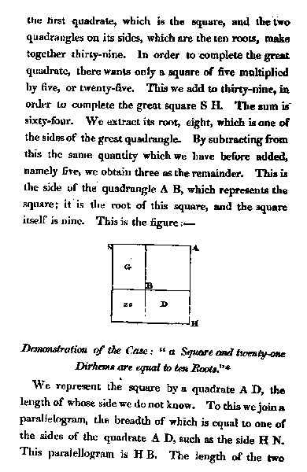
Origins of Algebra
An English translation of Al-Khwarizmi’s Algebra
“al-jabr” – completion – subtract one side of the equation, add to the other
“muqabalah” – reduction – cancel terms on opposite sides
Al-Khwarizmi (780-850)
Hisob al-jabr responsible for algebraic processes and adoption of Hindu numerals
Source: Wikipedia

Slide 16
Graphs and Infinities
Translation of Islamic texts in 12th century led to Greek (esp. Aristotelian) revival and adoption of Islamic math in the Latin West
Infinite Q’s:
Is infinity just potential or actual?
Are the infinite magnitudes or collections?
Does a line just contain points or consist of them?
Aristotelian “’’forms’’”: inherent qualities that change continuously (e.g. speed, heat)

Slide 17

Graphs and Infinities
Oresme (1325-1382)
“Latitude of Forms”-Graphical representation of quantities of certain qualities, e.g. motion over time
Infinite series – Theorem: The harmonic series diverges
Velocity
Latitude
Longitude

Slide 18
Renaissance: Developments in Algebra and Analysis
1500-1665
Algebra in earnest. New numbers and notation. Extending the moe. Infinitesimal methods. Marrying algebra and geometry. The rules of calculus.

Slide 19
Development of Algebra
Solving of the cubic (Tartaglia + Cardano) and quartic (Ferrari)
Vieta (1540-1603): Represent all polynomials of a given degree with one equation
Letters for knowns and unknowns
Comfort with rationals, negatives, and complex numbers growing
ax² + bx + c

Slide 20
Guess That Notation!
p | 1
1 | 2
p̅ m̅
R)².
3/2 Power
Square root
plus
minus (moins)
⑤ ② ①
cosa
∝
4 + 3 - 8
Unknown (thing)
Equals
4x⁵ + 3x² – 8x

Slide 21
Extending the MOE
Using lemmas as a shortcut for the MOE
Using infinitesimal methods in place of the MOE
Cavalieri (1598-1647)
Cloth = sum of threads, Book = sum of pagese
Theorem: Power rule ∫x^{n} (Later: Toricelli for rational powers)
Kepler (1598-1647)
Volumes of 92 shapes beyond Archimedes
Optimization

Slide 22
Analytic Geometry: Marrying Geometry and Algebra
“Analytic Geometry”: Associate each curve with an equation that implies the properties of the curve.
Graphical representation and algebraic equations intertwined.
Descartes’ (1596-1650) “La geometrie”
Fermat (1607-1665)
Used infinitesimals algebraically: Small change E -> calculate -> Let E = 0
Area under y²=x³ using tangent lines, using infinitesimals algebraically and geometrically

Slide 23
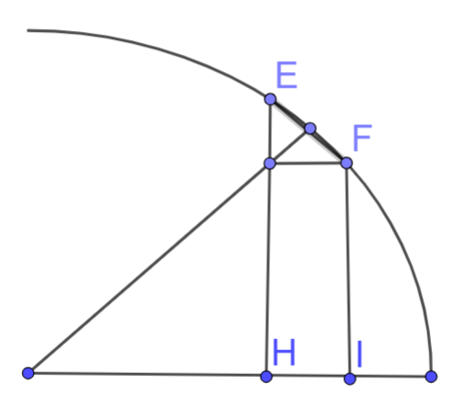
Inspirations to Newton and Leibniz
Pascal (1623-1662)
Differential triangle
“Pascal’s” Triangle
Theorem: Integration by Parts
Wallis (1616-1703)
Manipulating infinity algebraically, computed series
Introduced symbol ∞
Barrow (1616-1677) Newton’s mentor
Derivative and integral rules
Fundamental Theorem of Calculus
Differential Triangle

Slide 24
Birth of Calculus: Newton and Leibniz
1665-1687
Uniting the results of Calculus into a distinct field and general method.

Slide 25
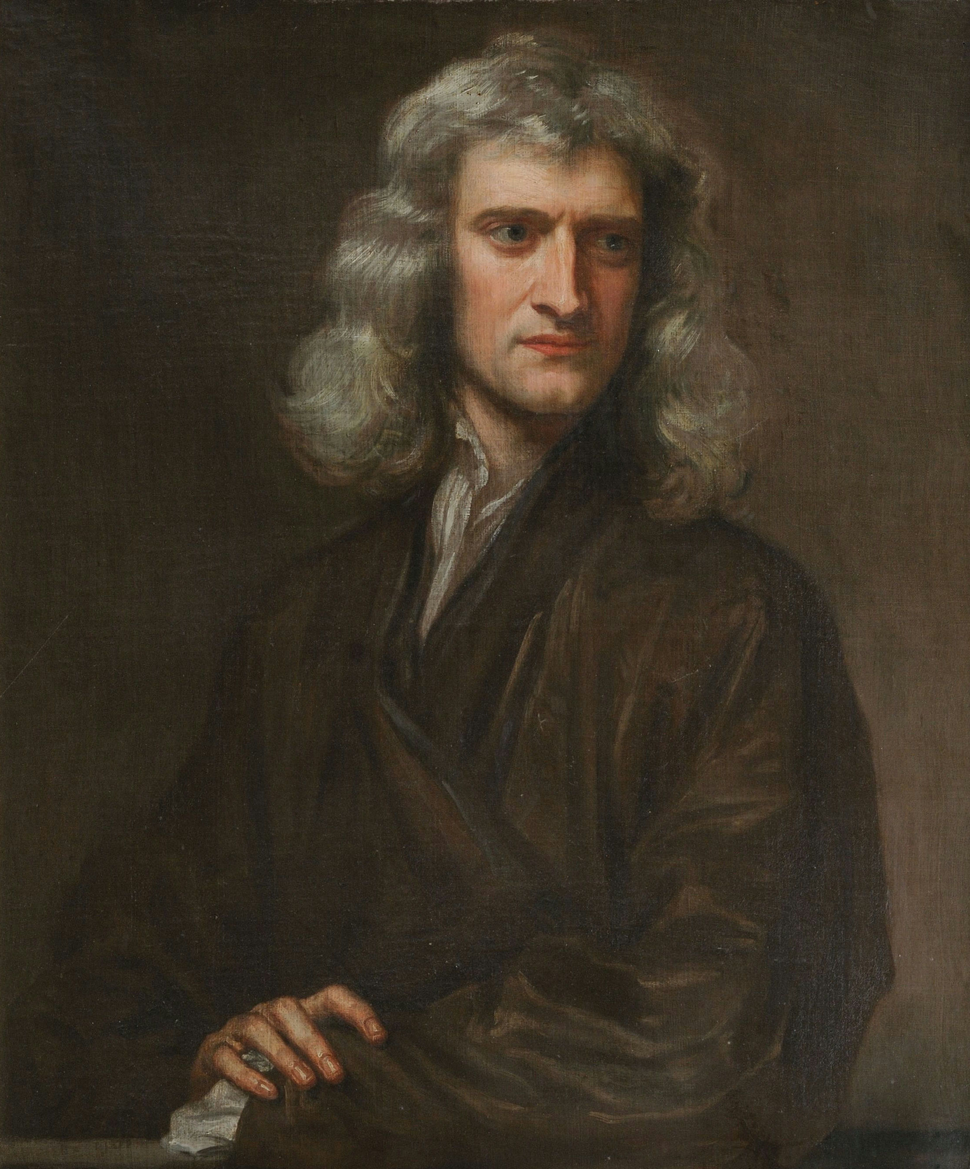
Newton (1642-1726)
Inspired by Binomial Theorem
3 treatises explaining the method of calculus 1665,1671,1676
+ Principia 1687
“Fluxions”: Rate of generation of a quantity
Rate of generation of a quantity: x
Quantity generated: x
The quantity for which x is a fluxion (i.e. “fluent”): x
.
‘
Source: Wikipedia

Slide 26
Example: Power rule for derivatives
Area = n/(n+m) x^{(m+n)/n}, Curve = ???
Small change in x -> x + o
Area + oy = n/(n+m) (x+0)^{(m+n)/n} = n/(n+m) x^{(m+n)/n} + x^{m/n} o + o²(stuff)
y = x^{m/n} + o(stuff)
y = x^{m/n}

Slide 27
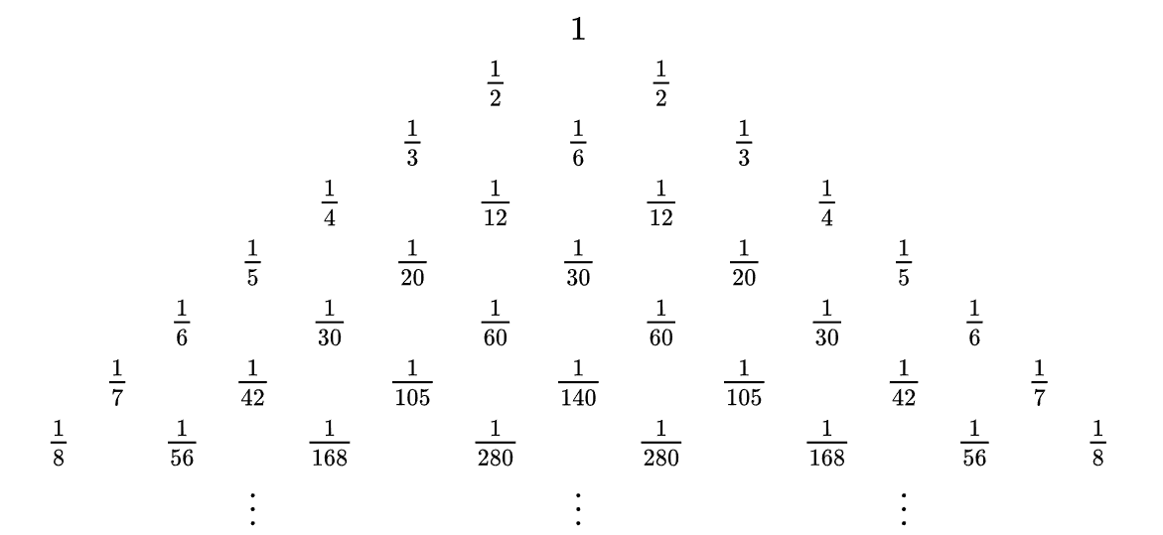
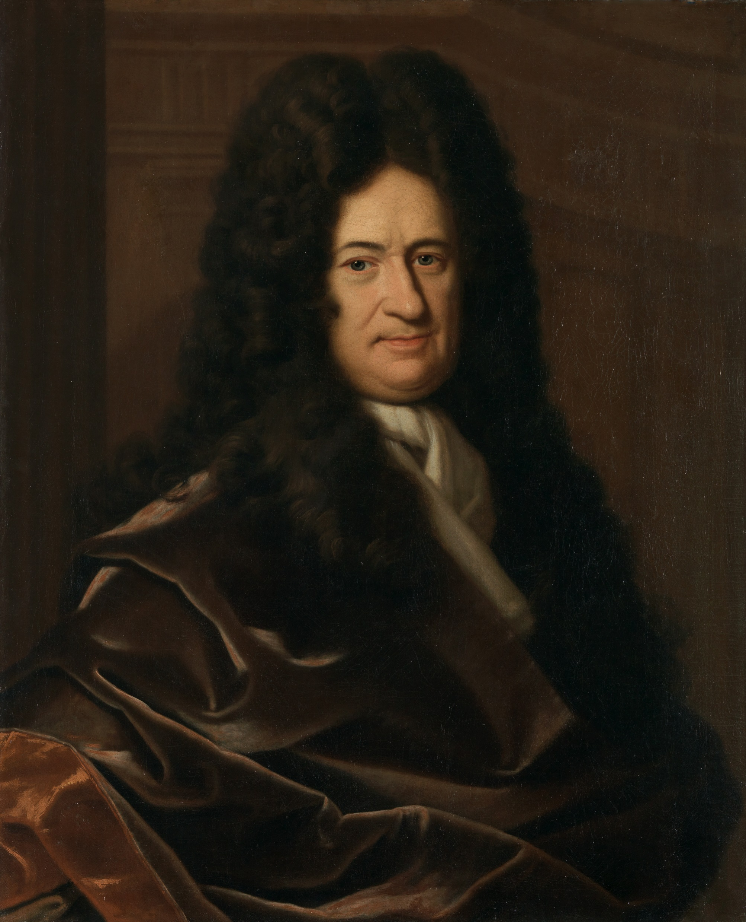
Leibniz (1646-1716)
Inspired by Paschal’s Triangle
Developed 1672-1676, Published 1684
“Differential and Summatory Calculus”: Differentials are fundamental
Notation: dx and ∫ydx
Source: Wikipedia
Source: Wikipedia

Slide 28
Calculus is invented. What’s left?
Integral
Derivative
Continuity
Limit
Function
Real number line
The Foundations!

Slide 29
Foundations of Calculus: Limits and the Calculus of Today
1687-1872+
Establishing the limit. Continuity. Convergent series. Epsilon-delta. The real number line. +Logical infinitesimals.

Slide 30
What is the logical foundation of Calculus?
General Problems:
How can we justify “cancelling zeros”? (Contradiction?)
How do we understand higher order differentials?
Answer 1: Fluxions
Problem: Relies on intuition about motion, which may not be correct or relevant
Answer 2: Differentials
Problem: General confusion. Higher order differentials
Answer 3: Functions (advocated by Lagrange (1736-1813))
Taylor series fundamental: f’(x) is just a coefficient
Problem: Not every function has a Taylor series expansion

Slide 31

Answer 4: Limits
“One quantity is the limit of another if the second approaches the first nearer than any given quantity, so that the difference between them is absolutely inassignable” –D’Alembert (1717-1783)
Advocated by L’Hulier in 1787 in response to Lagrange
1804 textbook by Lacroix popularized limits and Leibniz notation
Problem: Alleged “Law of Continuity”: “If a variable enjoys a property at all stages the limit will enjoy the same property” –L’Hulier
Relied on geometric intuition

Slide 32
Modern Definitions
Thanks to Cauchy (1789-1857)
Continuous functions
Infinitesimal is just a variable going to 0
Orders of vanishing -> Higher order differentials make sense now
Convergence of series
Lingering Problem: Number as length of line segment. Cauchy sequences should converge?

Slide 33

Real Number Line
Weierstrass (1815-1897)
Established epsilon-delta definition of limit
1872 constructed continuous nowhere differentiable function (shoutouts to Bolzano)
1872 Weierstrass, Cantor, Meray, Heine, and Dedekind constructed real numbers
Example (Dedekind Cut):
q² < 2
q² > 2

Slide 34
That’s it!
The results of calculus have been laid on a solid logical foundation, and thus most histories of calculus end with the construction of the reals in 1872.
But what if there is another logical foundation for calculus???

Slide 35
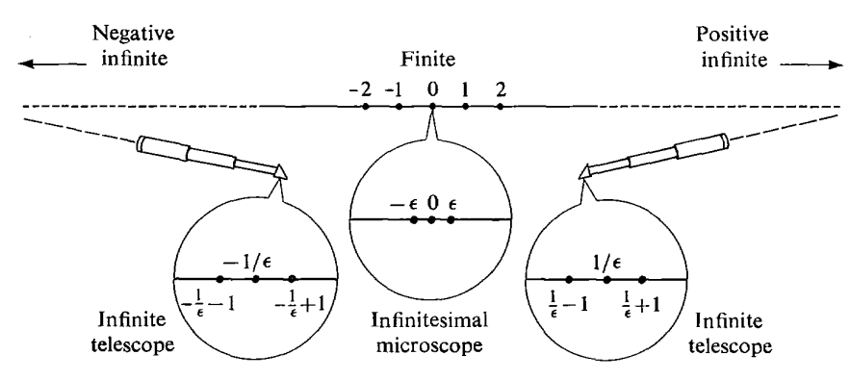
+Infinitesimals work!
1934 Skolem introduces ultraproduct
1948 Hewitt constructs hyperreals (includes infinite and infinitesimal numbers)
1961 Robinson gives rigorous treatment of calculus using hyperreals
The Hyperreal Number Line
Credit: H. Jerome Keisler, in Elementary Calculus: An Infinitesimal Approach

Slide 36
Thank you!

Slide 37
Sources/Further Reading:
Boyer, Carl. The History of the Calculus and its Conceptual Development
Boyer, Carl and Merzbach, Uta. A History of Mathematics
Keisler, H. Jerome. Elementary Calculus: An Infinitesimal Approach

